Slide 1


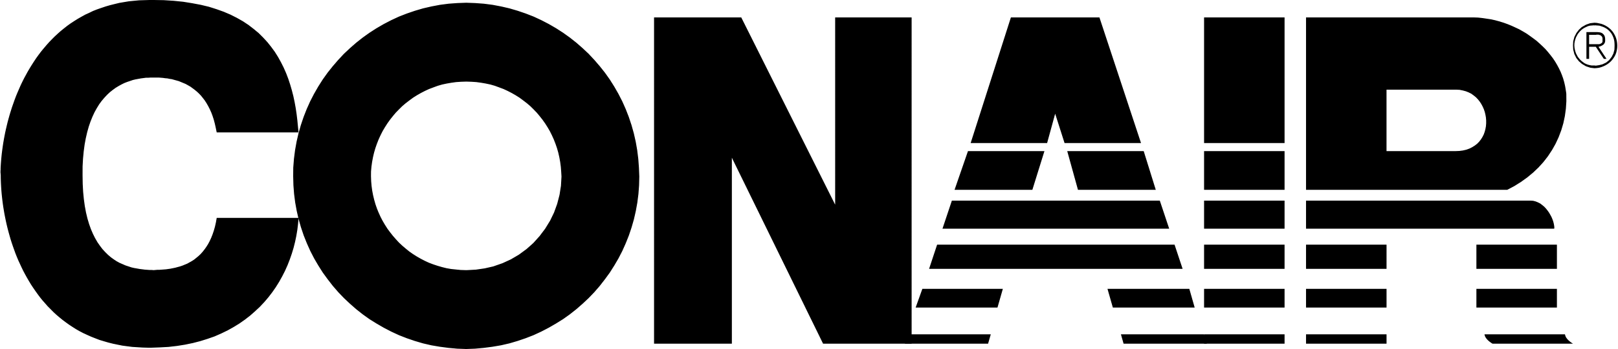
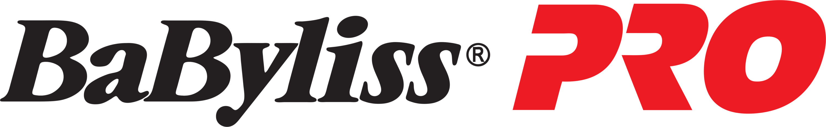
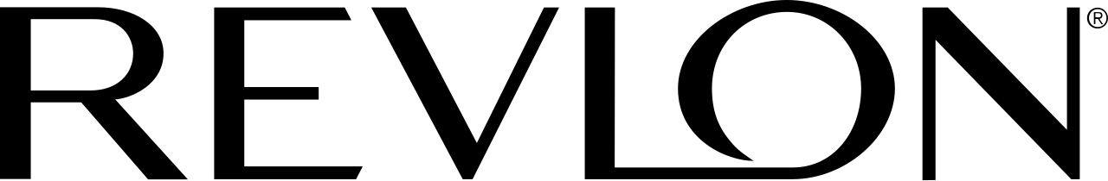
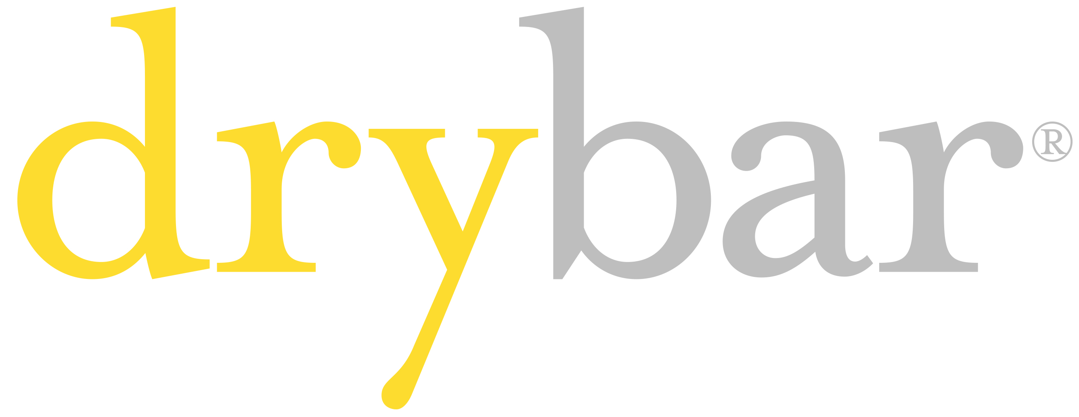
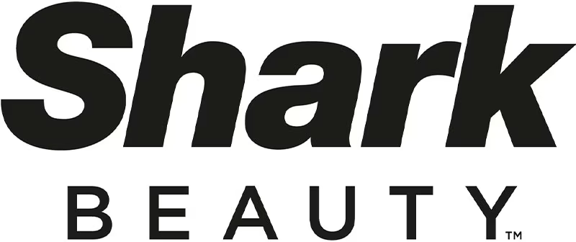
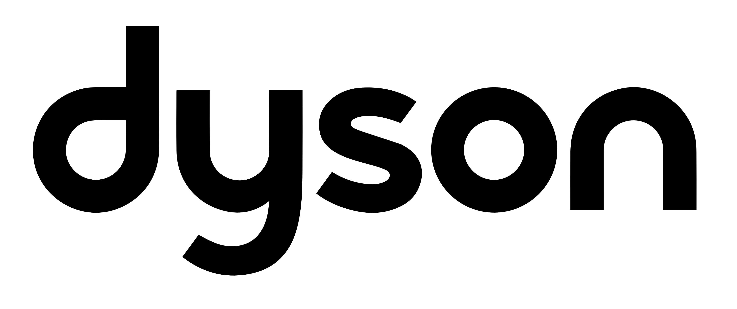
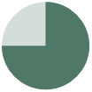

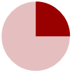
Conair strong on organic brand discoverability but has scope to invest in sponsored / display ads and to add product videos to its popular SKUs
overall_0_132168598270932522 columns_1_132168596824407661 35_0_132168596962513003 95_1_132168598152427144 11_1_132333747912432425 2_1_132340497957483601 3_1_132370564923967568 7_1_132369712644680626 12_1_132346367343270022 6_1_132369712448544121
E-commerce
Consumer journey / optimization
Directional
Key: Performance scale
Not Found
 | Metric |  |  |  |  |  |  | Explanation
SEE (off-site) | Product Listing Ads (leading to Amazon) |  |  |  |  |  |  | For brand-name search on Google, all the brands except BabylissPro and Dyson have PLA (Google Shopping Ads) that links to the product page on Amazon.
 | Social media campaigns (Amazon co-branded) |  |  |  |  |  |  | Conair, Revlon, and Shark have ads as a co-branding with Amazon on Facebook & Instagram in the last 12 months
 | Google search result leading to Amazon page of brand |  |  |  |  |  |  | For brand-name search on Google, all brands, except Dyson, have a search result (either organic or paid) in top 10 that leads to their listings page on Amazon.
SEE (on-site) | Brand Hub/Store |  |  |  |  |  |  | All brands have a dedicated store on Amazon. It helps a brand showcase all its hero products and highlight promotions, benefits, etc.
 | Display and video ads |  |  |  |  |  |  | Based on a sample of 5 high-volume keywords, Conair has no media ads, while Revlon leads with brand display banners. Display and video ads capture immediate attention; help drive awareness & sales.
FIND (on-site) | Sponsored listings |  |  |  |  |  |  | Conair and Dyson have no sponsored SKU on any of the industry keywords analysed. Revlon and BaByliss Pro have ~5 sponsored listings each on 5 keywords analysed.
 | Appearance in featured brands / brand filter |  |  |  |  |  |  | Based on a sample of 5 high-volume keywords, Conair makes an appearance in the list of brand filter 100% of the times, similar to Revlon
 | Total listings & Amazon badges (overall pick/ best seller) |  |  |  |  |  |  | Conair leads with ~40 listings (cumulative) on top 5 industry keywords analyzed, while Revlon follows next with ~30. Conair is strong on “hair dryer” and “compact hair dryer” keywords (10 or more listings); its product appear as an 'overall pick' in 4 of the 5 keywords analyzed
 | % Appearance in top-20 spots |  |  |  |  |  |  | Conair has a presence in top results (first 4 rows) for 100% of the sample 5 industry keywords followed by Revlon at 80%; limited presence in top results for the other four peers
BUY (on-site) | Product title & description¹ |  |  |  |  |  |  | Conair’s hero SKUs have good product titles (using high-volume SEO keywords) and detailed product description points
 | Product images and videos¹ |  |  |  |  |  |  | Good use of multiple high-quality images and videos by Shark and Babyliss Pro; limited use of videos by Conair
 | Price range distribution |  |  |  |  |  |  | On the results page for a brand, Shark and Dyson have the widest price ranges available (>$300); Conair has a narrower SKUs range of ~$200
 | Subscribe & Save option |  |  |  |  |  |  | ~60% of the listings of Drybar have the option to “subscribe & save” – helpful for retaining customers and building brand loyalty; for Conair, only 5% of the listings come with this option
 | Stock availability |  |  |  |  |  |  | Almost 100% of Conair's SKU listings have no low stock or out of stock issues, similar to Drybar
 | Ratings & Reviews¹ |  |  |  |  |  |  | Conair and Revlon have strong customer advocacy with 4.4 overall average rating across their top 3 Hero SKUs, while BaByliss Pro leads with a 4.6 average rating
Strong
Average
Weak
Found
Note: 1) Product-level metrics evaluated for top 3 ‘hero SKUs’ of brands, in terms of their best-selling rank on Amazon; Hair accessories like scrunchies, hair clips etc. excluded from the analysis Source: Amazon.com (ZIP code of NYC), Meta Ads Library

Slide 2
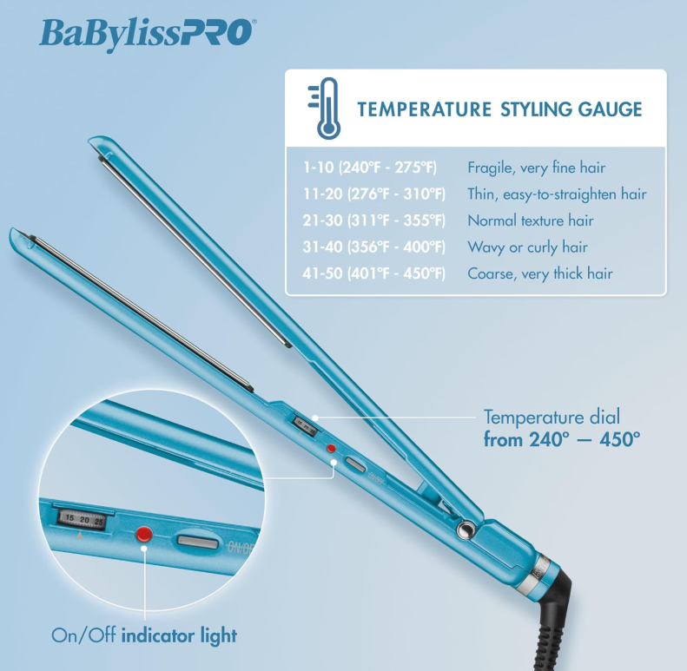
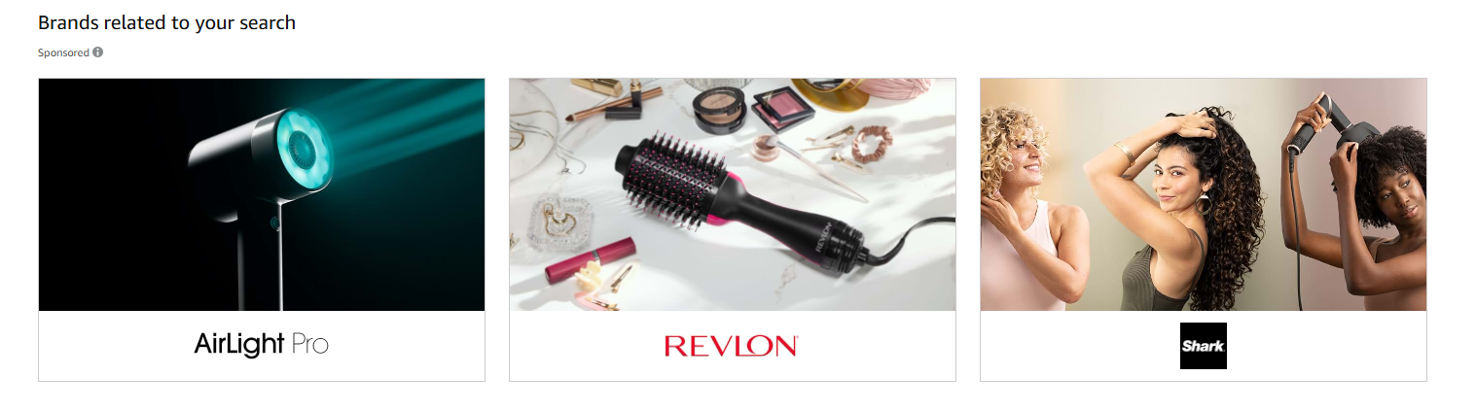
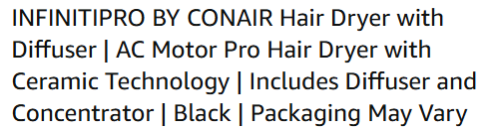
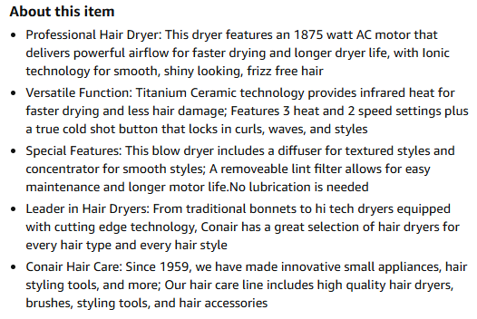
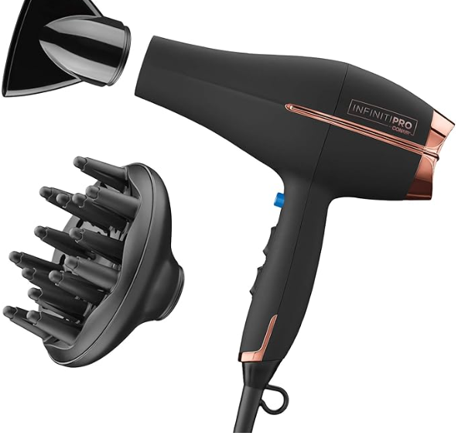
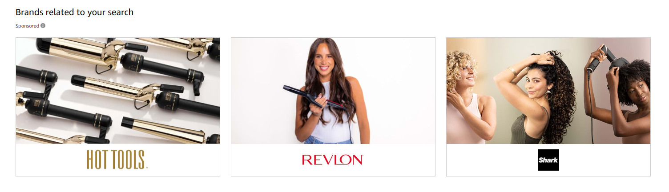
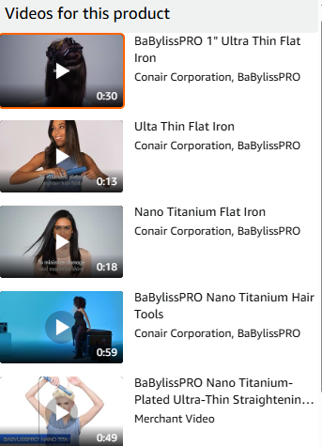
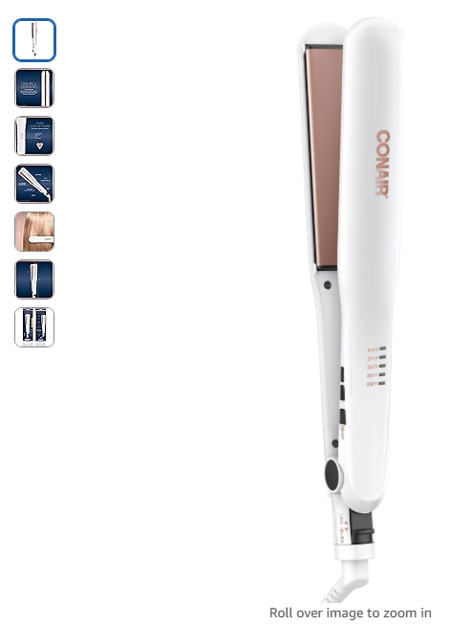
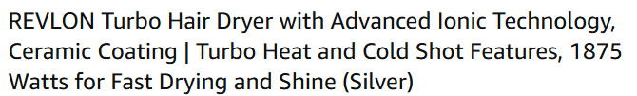
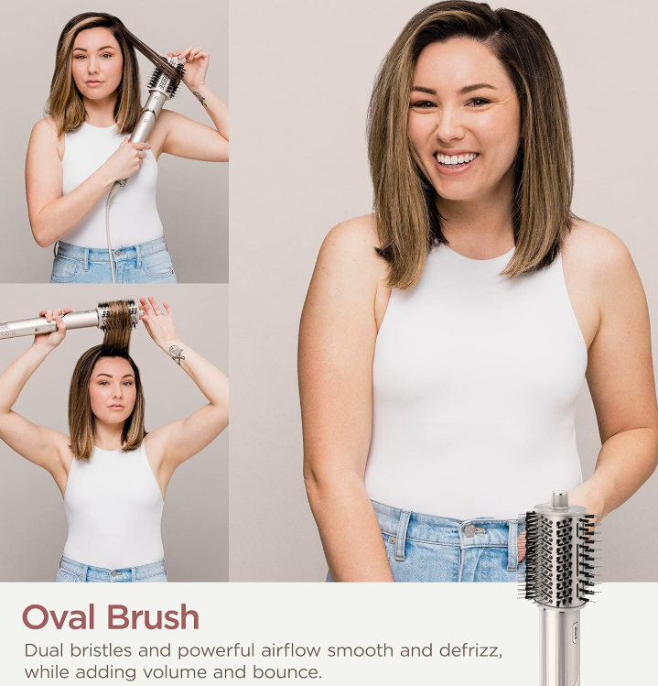


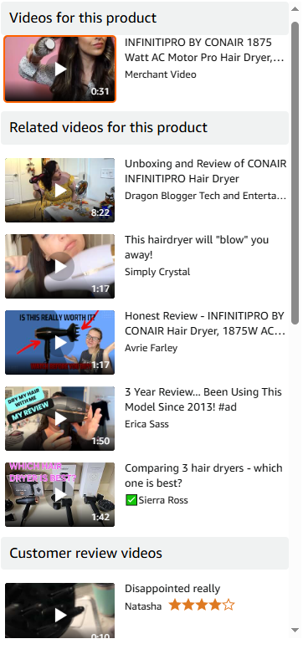
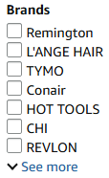
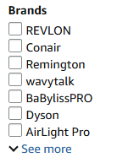
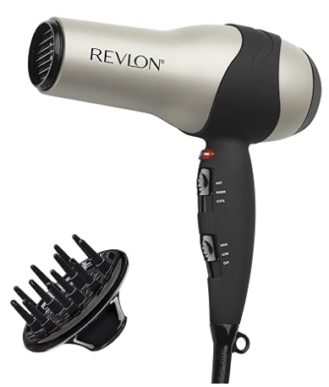
To better compete w/ Shark, Babyliss, Revlon, Conair could add high-quality media and run banner/video ads on popular keywords to generate more awareness / clicks
overall_0_132168598270932522 columns_1_132168596824407661 35_0_132168596962513003 95_1_132168598152427144 11_1_132333747912432425 2_1_132340497957483601 3_1_132370564923967568 7_1_132369712644680626 12_1_132346367343270022 6_1_132369712448544121
E-commerce
Consumer journey / optimization
Directional
Product pictures and videos
Display & video ads & Brand filter
SKU title and description
BaByliss provides detailed information about heat settings and multiple videos showing steps and tips to use products
BaByliss provides detailed information about heat settings and multiple videos showing steps and tips to use products
Conair can publish more videos elaborating tips to use the products, key benefits etc.
Conair gains an edge in brand-discovery & provides ample info to consumers by having detailed description for its products, covering specifications, functionality & features, making the purchase an informed decision
Peers like Revlon have brand banners for keywords such as “hair dryer” and “curling iron”; scope for Conair to run video ads and banners which are more appealing to customers and drive higher user engagement
Shark Beauty shows high quality product images explaining / showcasing the products’ use
Conair appears in brand filter for top keywords- ‘hair dryer’, ‘curling iron’, ‘hair straightener’, ‘hair curling wand’ and ‘compact hair dryer’
Scope for Conair to improve conversions from its product titles, by ensuring details as primary product specifications, expected results, are always included, as done by peers such as Revlon
Source: Amazon.com (ZIP code of NYC)

